Slide 1
PHASE 2: REQUIREMENT ANALYSIS
“Give me six hours to chop down a tree and I will spend the first four sharpening the axe.”

Slide 2
Outline
Introduction
Stakeholders
User Requirements
Administrator requirements
Technical requirements
Business Requirements
Requirements from client
Requirement prioritization
Prioritization Criteria.
Assigning Priorities to requirements.
Requirement Categorisation.
Detailed requirement specification document
Goal Of The Implementation
Functional Requirements:
Non-functional Requirements
Business Model

Slide 3
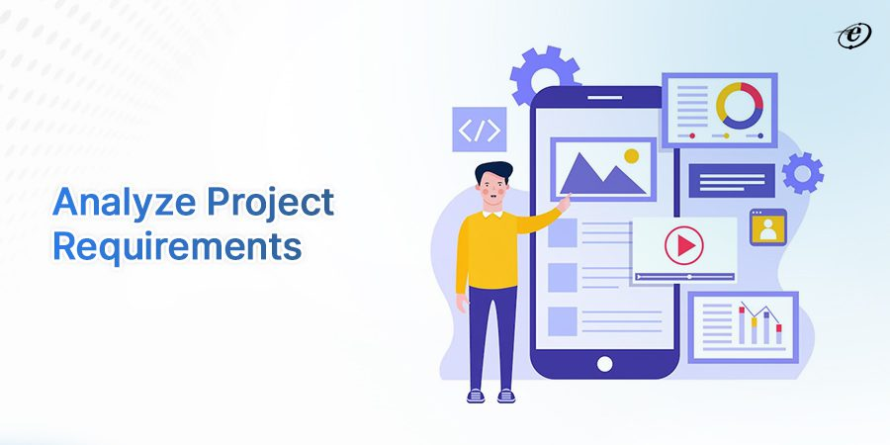
INTRODUCTION
What is requirement Analysis.
Prioritizing
SRS
Business Goals.
Importance
Compass guiding development process
Make sure stakeholders expectations are met.
Make sure business goals are met
Foundation of design.

Slide 4
STAKEHOLDERS
End Users
Administrators
Technical Team
Project Sponsor and supervisor (client)

Slide 5
USER REQUIREMENTS
Functional requirements
Location Tracking
Provide Notification System
Non-functional requirements
User-Friendly Interface
Efficiency and Performance
Reliability and Accuracy

Slide 6
ADMINISTRATOR REQUIREMENTS
Database Management:
add, update, and remove archived objects from the database
User Management:
creating and managing user accounts with different access levels and permissions.
monitoring user activity, tracking login/logout sessions, and auditing changes made by users.
System Configuration
configuring system preferences, such as notification preferences, search parameters, and default display options
User Support:
help desk services, and training materials

Slide 7
TECHNICAL REQUIREMENTS
Image Processing Algorithms:
image segmentation techniques
image enhancement
image recognition algorithms for object detection
Database Management:
scalable database schema to store archived objects and associated metadata.
Implementation of data indexing
System Architecture:
Design of a MVC (model, view, controller) architecture coupled with micro service architecture for a modular and scalable development.
Integration with External APIs or Services:
external image databases
APIs for sending notifications to users
Geolocation API

Slide 8
BUSINESS REQUIREMENTS
Enhance Customer Experience
lead to higher adoption rates and customer loyalty.
Increase Operational Efficiency
reduce operational costs.
Leverage Advanced Technology
will differentiate the application from competitors and provide a unique value proposition.
Ensure Data Security and Compliance
crucial for building user trust and avoiding legal issues.
Generate Revenue
Creating revenue streams will help sustain the application financially
Support Scalability and Growth
Accommodate growing user numbers and evolving business needs

Slide 9
REQUIREMENT EXTRACTION FROM CLIENT PROBLEM DEFINITION
Functional Requirements:
User Registration and Authentication
Image Upload and Storage
Image Matching and Retrieval
Search Functionality
Notification Functionality
Intuitive User Interface
Crowdsourcing and Community Engagement
Non-Functional Requirement
Security and Privacy
Performance
Scalability
Reliability
Compatibility

Slide 10
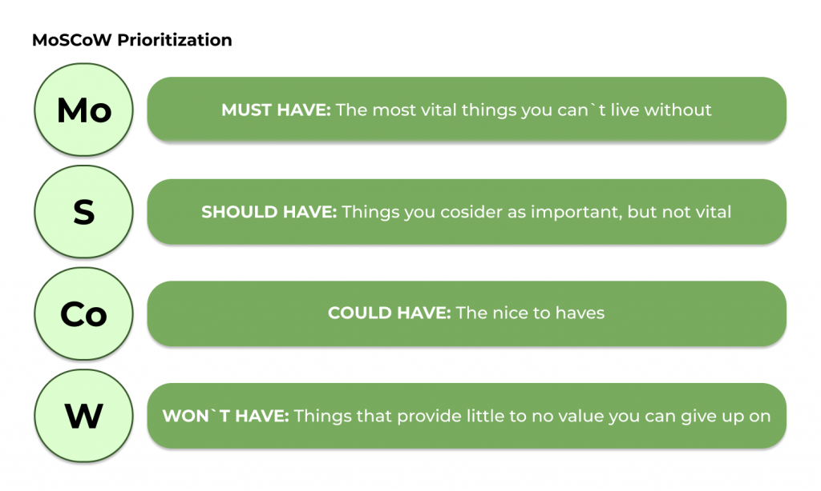
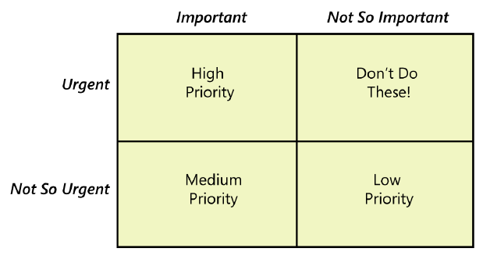
REQUIREMENT PRIORITIZATION

Slide 11
PRIORITIZATION CRITERIA.
User Impact: User Experience.
Business Value: does it align with business requirements?
User Input: do the user want it ?
Technical Feasibility: is it posible ?
Time Sensitivity: How urgent it is.

Slide 12
ASSIGNING PRIORITIES TO REQUIREMENTS.
Does it satisfy most of the criteria? => high priority
It Satisfy An average of the criteria => medium priority
Satisfy less than average of the criteria =>low priority

Slide 13
ASSIGNING PRIORITIES TO REQUIREMENTS.
E.g. Search missing object- :
Urgent
Aligns with business requirements
Technically feasible
Approved by the users
Hence high Priority
Provide Notification System
Not urgent as we can use external systems
Not directly aligned by the user
Technically feasible
rejected by most users.
Improve user experience
Hence medium priority

Slide 14
REQUIREMENT CATEGORISATION.
High Priority
Functional requirement
Upload Images of Lost Items
Search for Potential Matches
Utilize Image Matching Algorithms
User Support.
Implement Computer Vision Techniques
Register and Login
Database Management
User Management
High Priority
Non-Functional Requirements
Ensure Data Privacy and Security
User-Friendly Interface
Efficiency and Performance
Reliability and Accuracy

Slide 15
REQUIREMENT CATEGORISATION.
medium Priority
Functional requirement
Crowdsourcing and Community Engagement.
System Configuration.
Monitoring and Maintenance.
Provide Notification System.

Slide 16
DETAILED REQUIREMENT SPECIFICATION DOCUMENT
Goal Of The Implementation
Detailed Functional Requirements.
Non-Functional requirements.
Data Requirement
System Architecture
Business Model

Slide 17
DETAILED FUNCTIONAL REQUIREMENTS.
Uploading image of Found object to the system
Input: Image and Additional data
Process: The image and metadata are securely transmitted to the server using encryption protocol
Output: The user receives a confirmation message indicating the successful upload of the image and details.

